Slide 1



Job Recommendation System
Team:
U18CO009 Keyur Tarsariya
U18CO010 Ganesh Jadhav
U18CO018 Shubham Shekhaliya
U18CO039 Jigar Nainuji
Guide :
Sankita J Patel
Assistant Professor at NIT-Surat

Slide 2




Recap
Problem Statement
Proposed work

Slide 3



Main Challanges
Accurately Extraction the data from resume
Efficiently classified the job descriptions and Efficiently clustered the resumes.
Recommend the top-n matching items

Slide 4
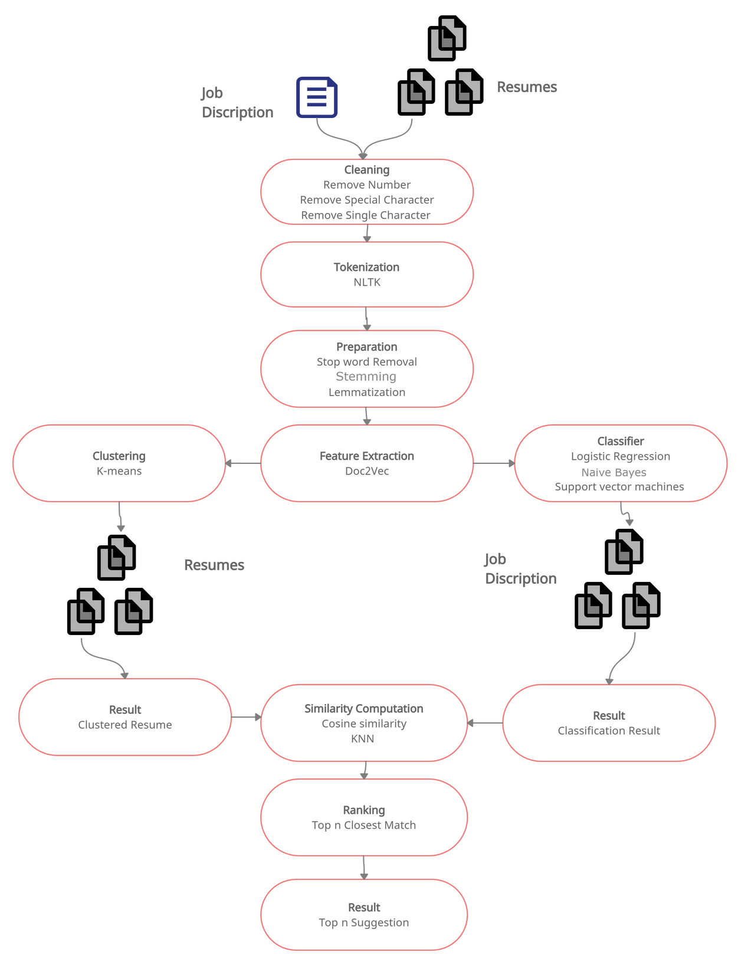
Proposed Methodology
PITCH DECK V 1.0

Slide 5
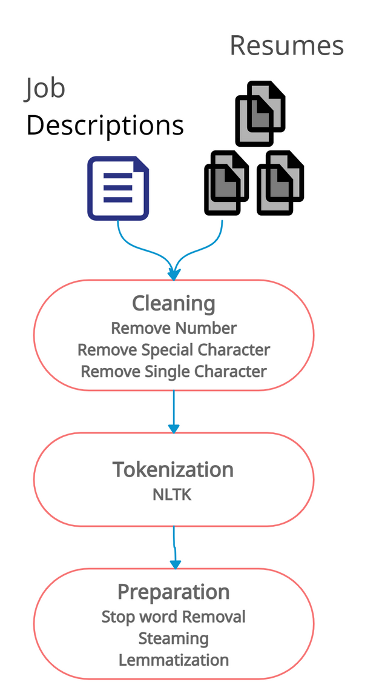
Data Preparation
Transforming into lower case
Individual words are extracted and tokenized with the help of white spaces and line breaks
stemming and lemmatization are performed to convert the given word into a root word
Elimination of white spaces, newline and punctuation marks.
Removal of stop-words such as ”a”, ”an”, ”the” etc.
Removal of non-ASCII keywords
PITCH DECK V 1.0

Slide 6
Extracting Information
Extract the information from the resume
Name
Skills
Email address
Phone number
Methods
regex
Pos Tagging
PITCH DECK V 1.0

Slide 7
Classification of Job description
What is the need for Classification in our project?
Labelled job description data
Multiclass classification
Different Classifiers
Multinomial Logistic regression
Support Vector Machine
Multinomial Naive Bayes

Slide 8
Doc2Vec
Feature Extraction
Convert word into numerical values
Different hyperparameter

Slide 9
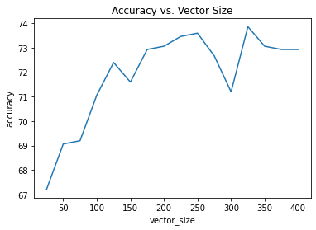
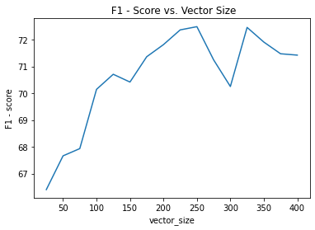
Selection of Hyperparameters for Doc2Vec
Vector Size
Accuracy vs. Vector Size
F1 - Score vs. Vector Size
At constant window = 10 and epochs = 30

Slide 10
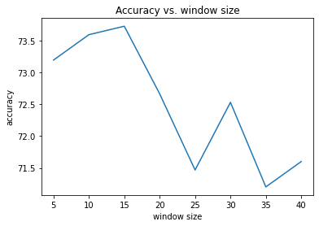
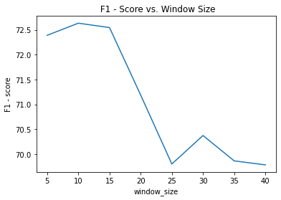
Selection of Hyperparameters for Doc2Vec
Window Size
Accuracy vs. Window
F1 - Score vs. Window
At constant Vector Size = 325 and epochs = 30

Slide 11
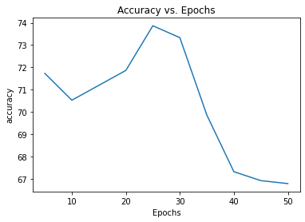
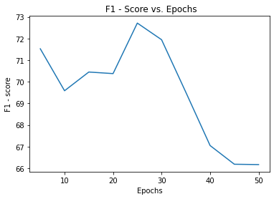
Selection of Hyperparameters for Doc2Vec
Epochs
Accuracy vs. Epochs
F1 - Score vs. Epochs
At constant Vector Size = 325 and Window = 15

Slide 12
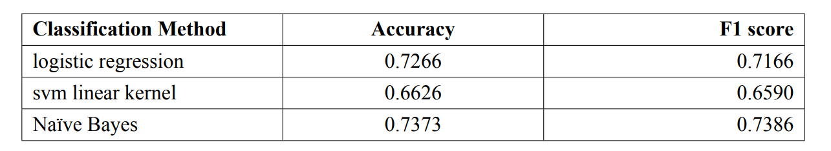
Classification Result Analysis
Comparison of result

Slide 13
Clustering of Resume
What is the need for Clustering in our project?
Two-way recommendation system
Need to iterate each resume and It's Time-consuming
Make the cluster of various resumes
Find similarities between each cluster representative and job
Choose a high similar cluster
basically, it will improve the time complexity

Slide 14
Clustering of Resume
Why are we doing clustering for resumes, not for the job description?
The job description has a job title that works as class and features extracted will work as a tag
Resume doesn't have any class name which can work as class
To make a group we need to use clustering

Slide 15
The basic flow of Clustering
Clean and preprocess the resumes data
Extract features from resumes
K-mean need input in numerical only so we need to convert its features words into vectors
Cluster the large data of resumes using k-mean algorithm
Also, K-mean algorithm need an input value of K which denotes the number of clusters we want to make

Slide 16
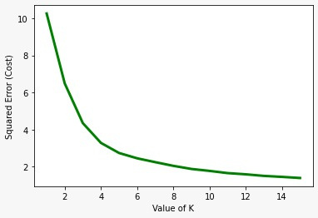
Clustering Result Analysis
Elbow method
Squared Error vs value of K

Slide 17
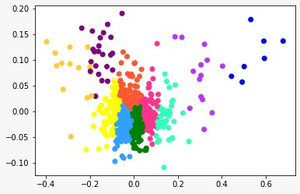
Clustered Resumes
clusters of resumes when we choose
k = 10 for k-mean algorithms

Slide 18
Our progress on the project
Completed
data extracting, cleaning and preprocessing of data
Modified job description dataset
classification of The job description
clustering of resumes
Future Work
Improve clustering of resumes
Implement similarity part

Slide 19
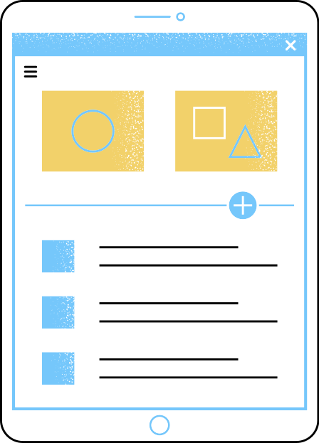




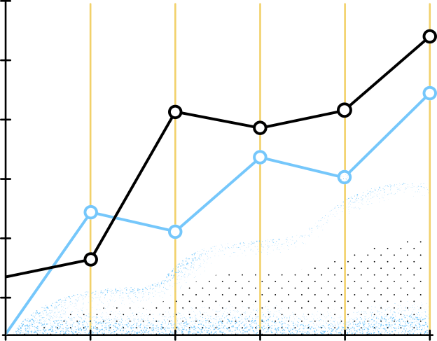


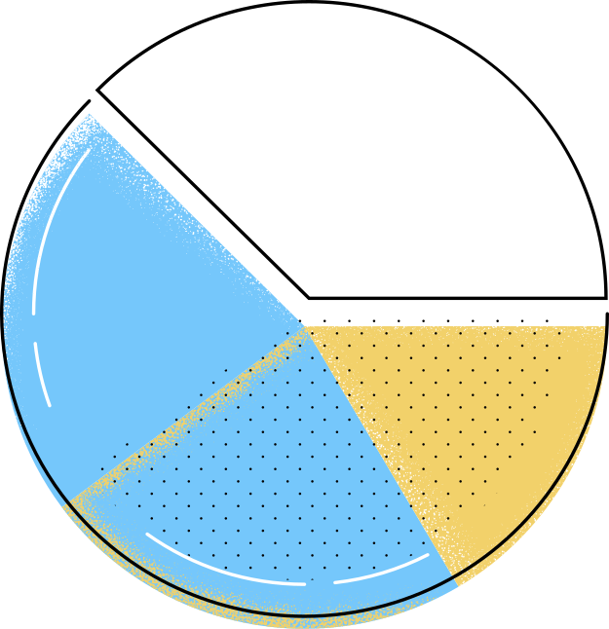





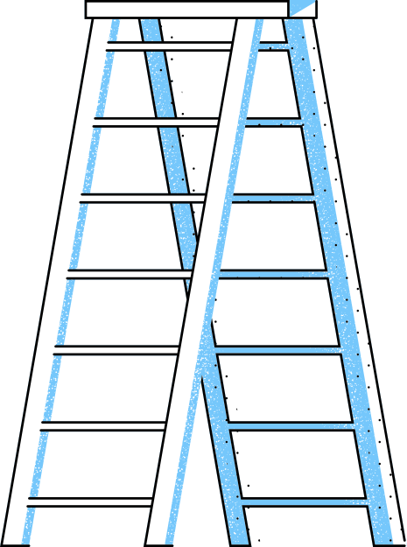
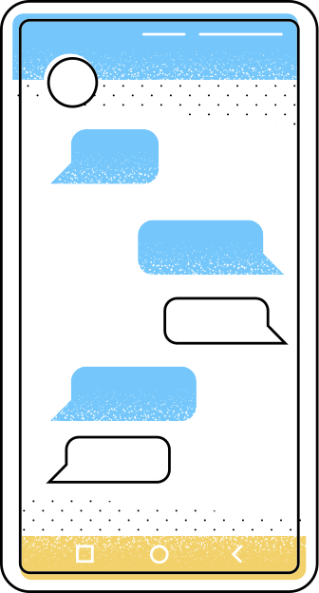
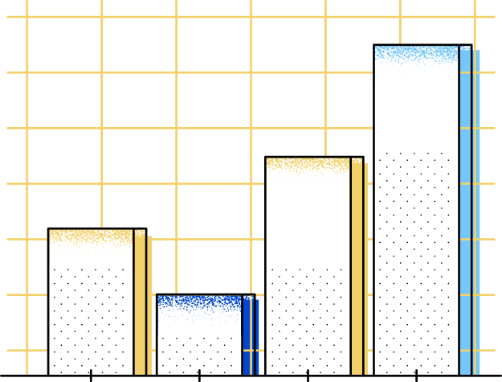



Thank You
A big Thanks to Dr Sankita J Patel for giving us the opportunity

